Slide 1
LECTURE 04:
DATA VISUALIZATION 101
March 2, 2021
CSC/SDS 235
Visual Analytics

Slide 2
Outline
Visualization overview
Graphical primitives
Visual dimensions
Common visualization techniques
Time permitting: Tableau demo

Slide 3
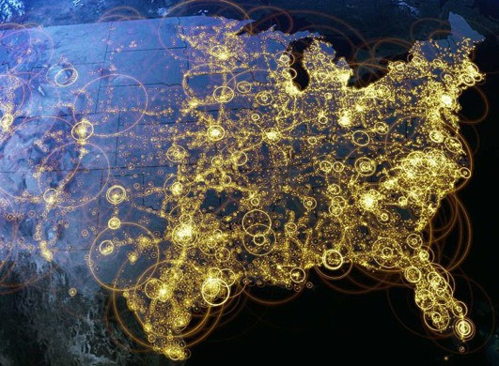
Recap: Jordan’s (def.)
Visual representations of data that reinforce human cognition

Slide 4
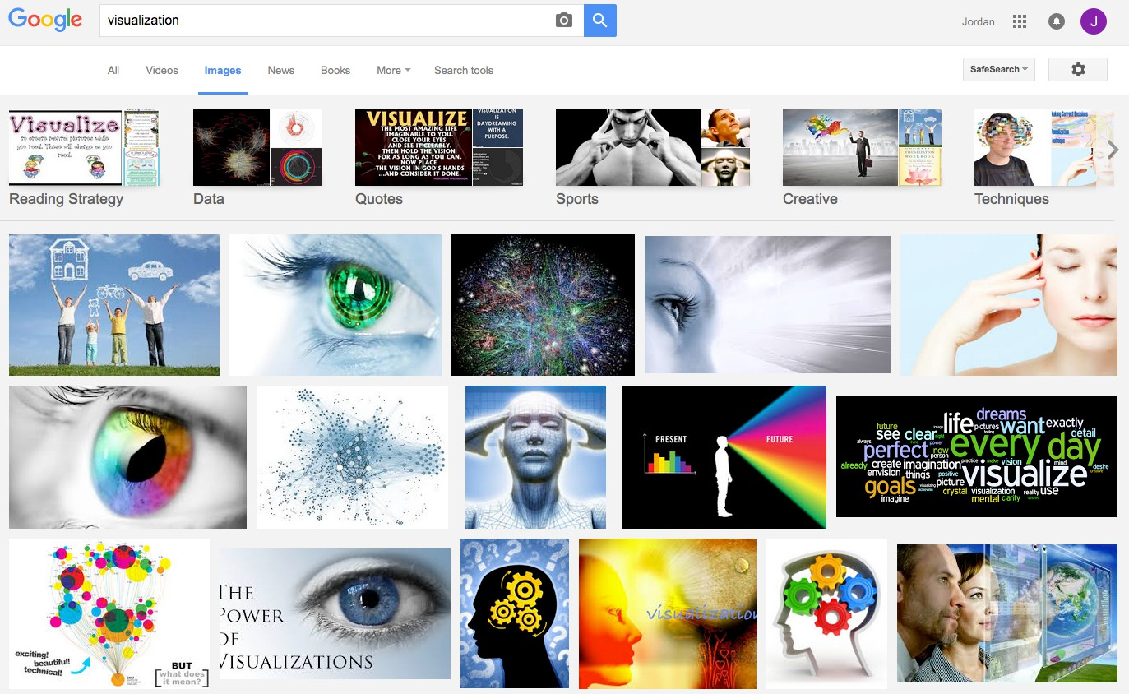
What is visualization?

Slide 5
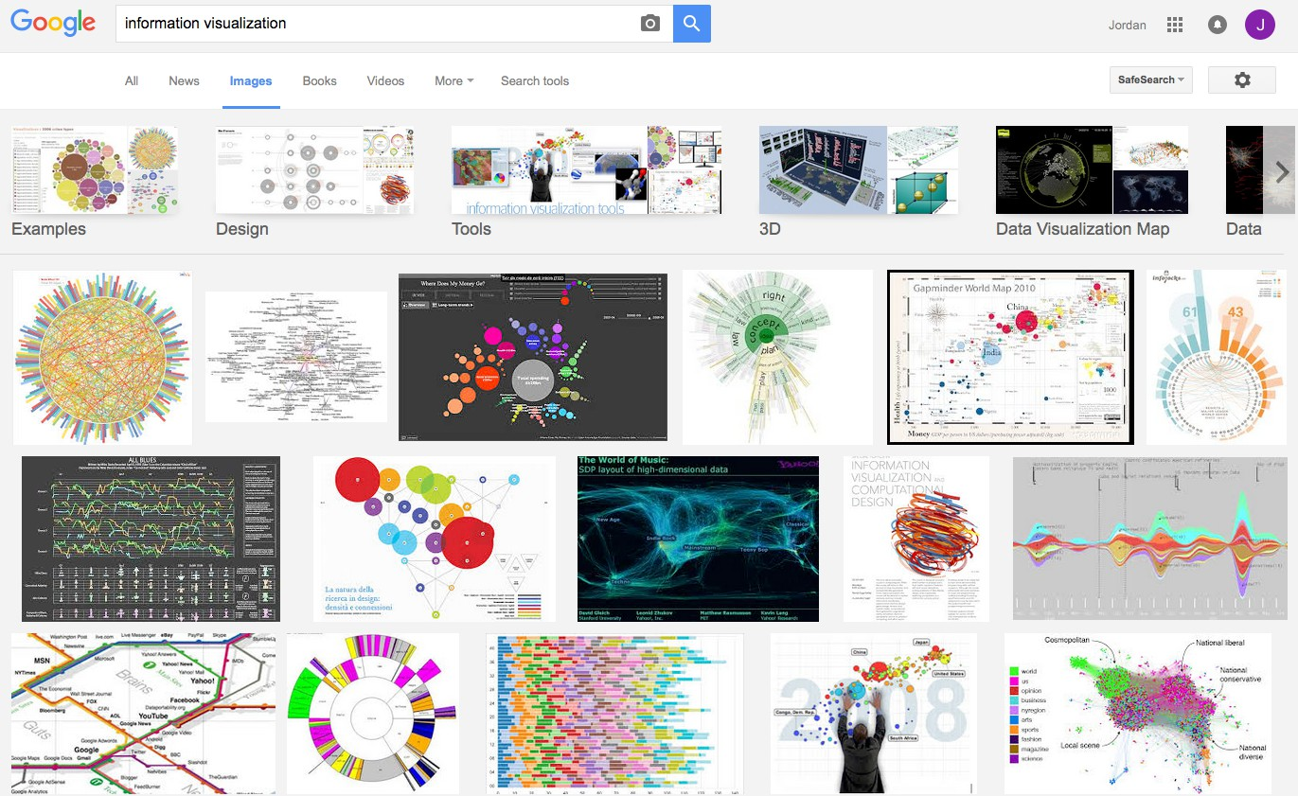
What is visualization?

Slide 6
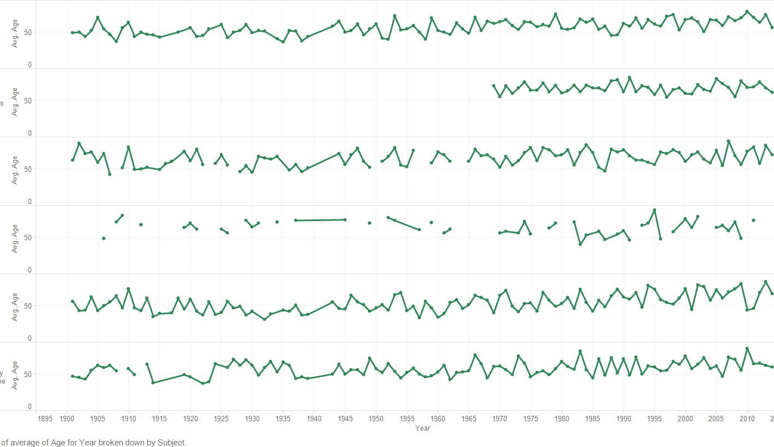
Is this visualization?

Slide 7
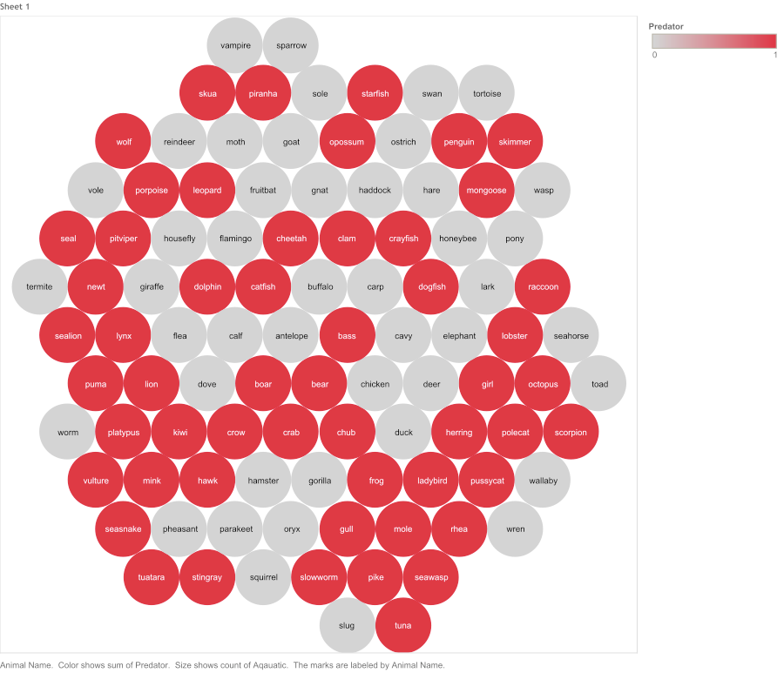
Is this visualization?

Slide 8
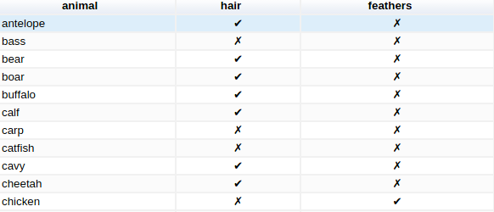
Is this visualization?

Slide 9
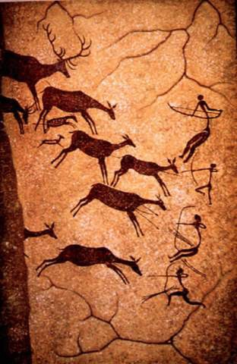
Is this visualization?
15,000 BC. Laxcaux, France

Slide 10
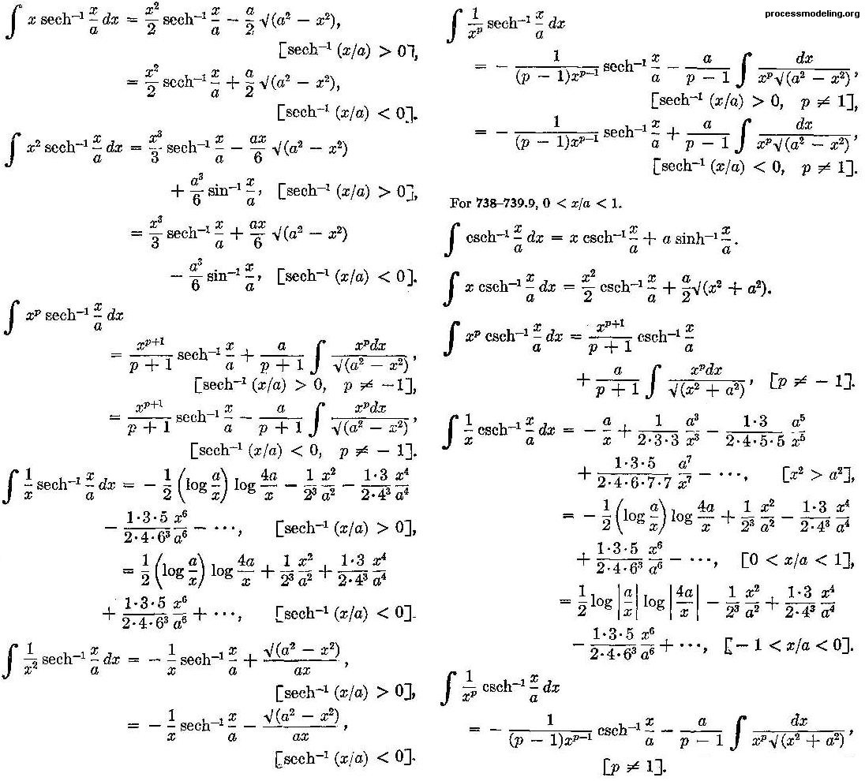
Are these visualizations?

Slide 11
What about this?
Hello World!

Slide 12
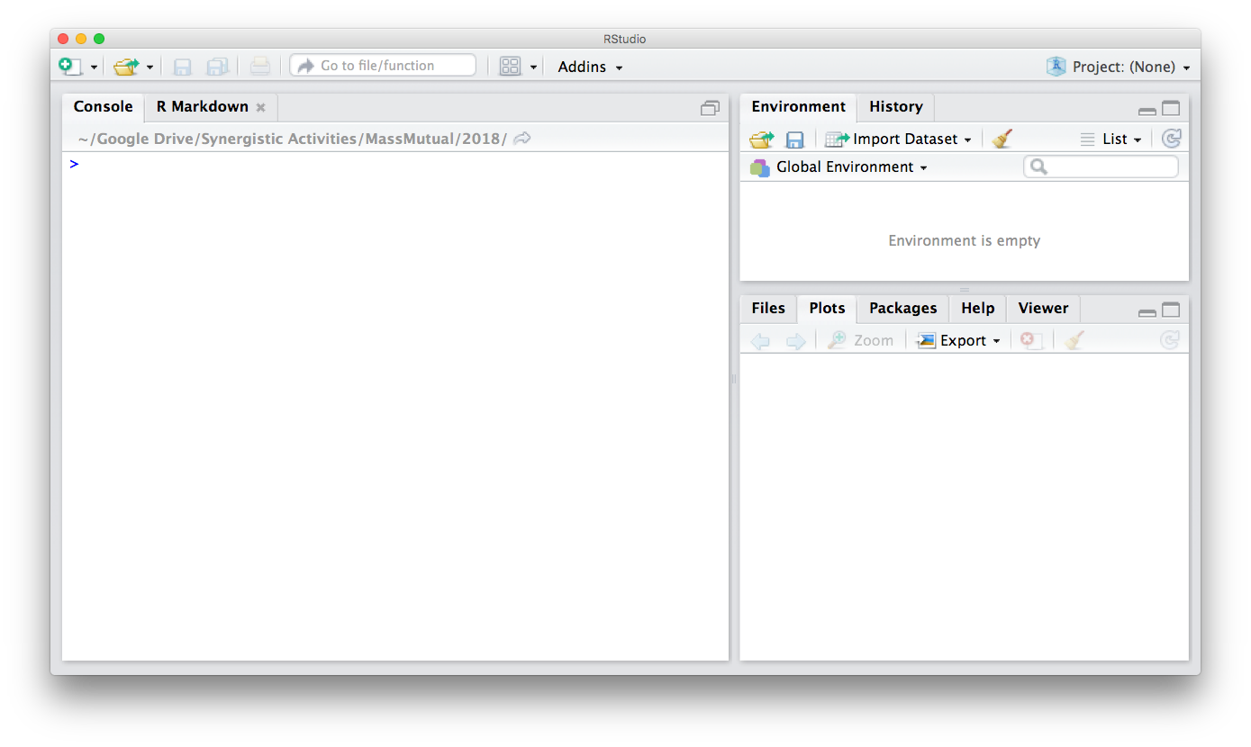
Think back to data wrangling…

Slide 13
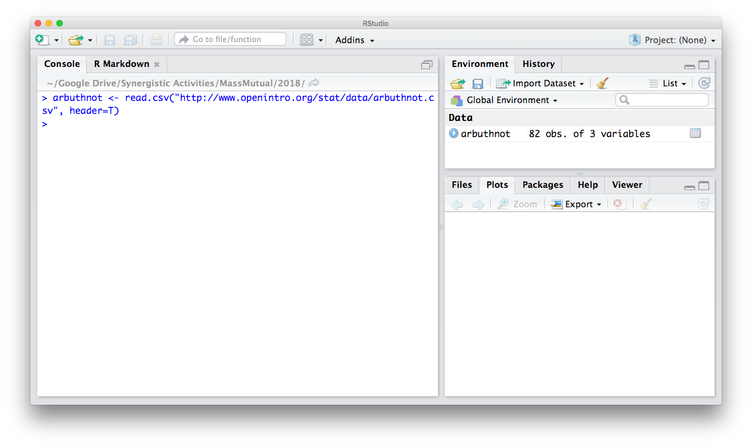
Think back to data wrangling…

Slide 14
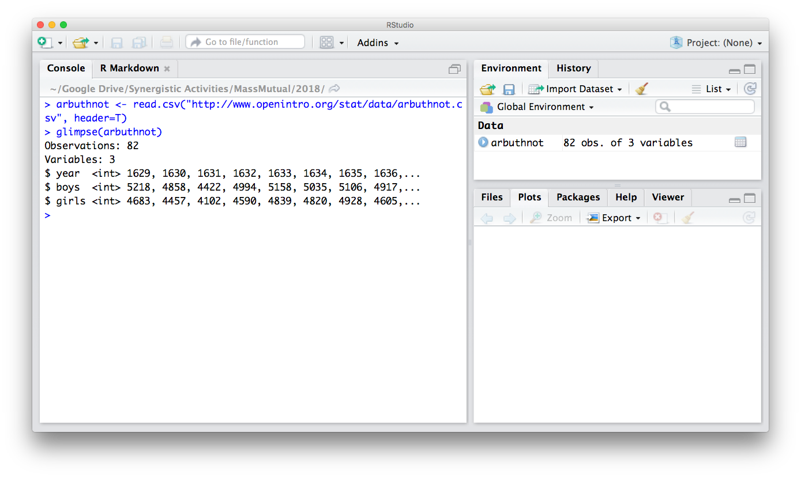
Think back to data wrangling…

Slide 15
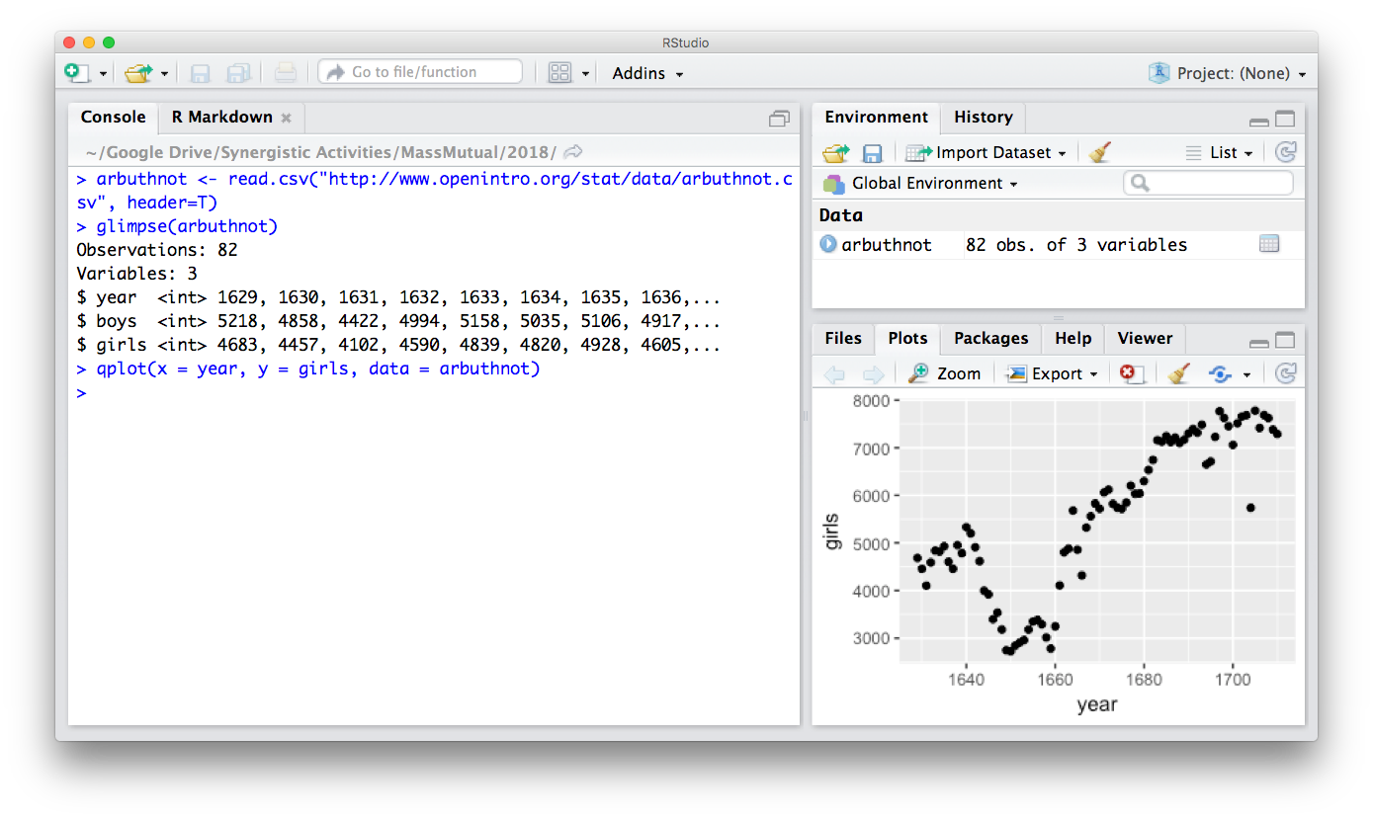
Think back to data wrangling…

Slide 16
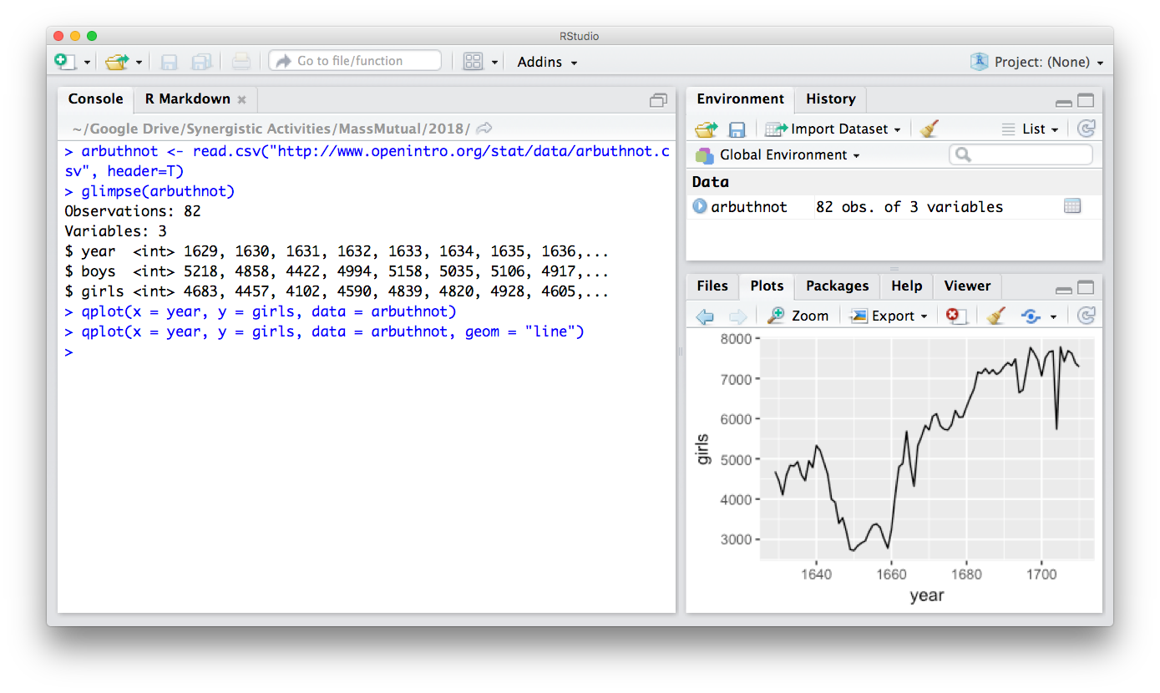
Think back to data wrangling…

Slide 17
Perhaps a more helpful question:
What are some ways visualizations can be useful?

Slide 18
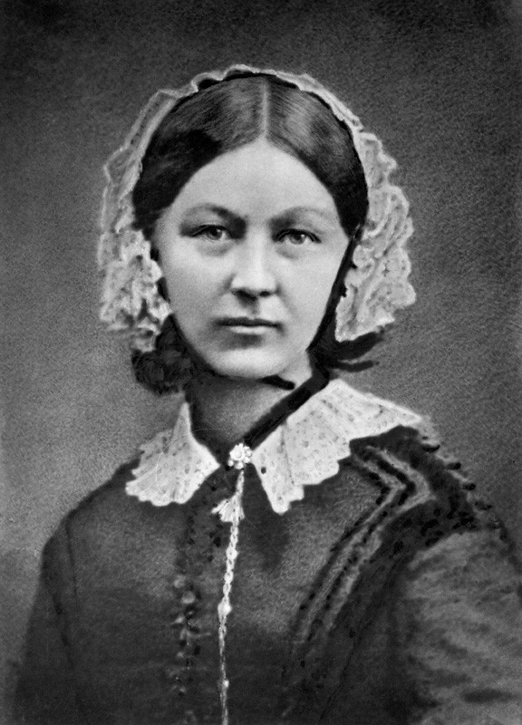
Do they help prove a point?
Florence Nightingale
British nurse in 1800s
Also a data journalist
Used statistical graphics to report to Parliament
One of her most famous contributions illustrated the impact of hospital reform

Slide 19
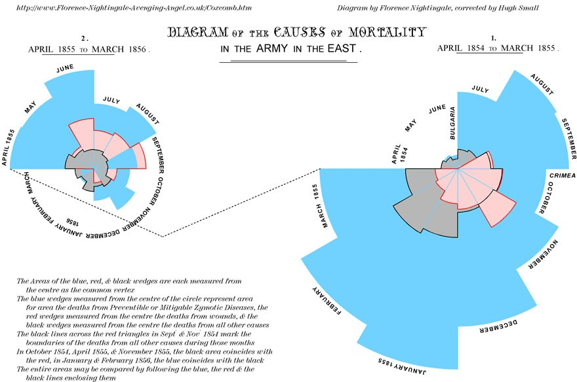
Does it help prove a point?

Slide 20
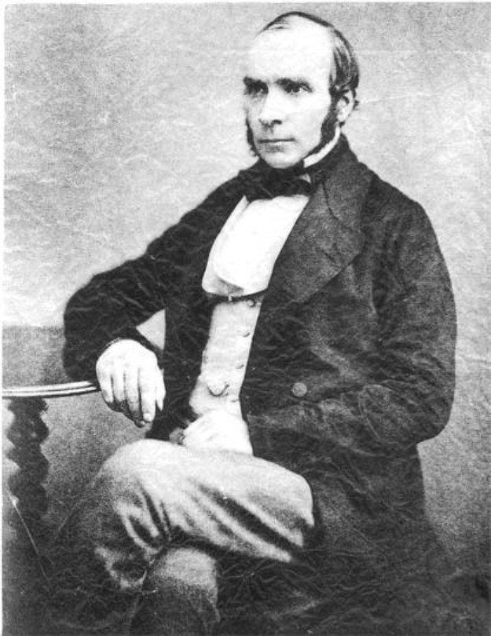
Does it help you spot trends?
In 1854, cholera broke out in London
127 people near Broad St. died within 3 days
616 people died within 30 days
Initial explanation:
“Miasma in the atmosphere”
Dr. John Snow was the first to link the outbreak to contaminated water
How did he do it?
Talked to local residents
Identified a water pump as a likely source
Used maps to illustrate his theory
Convinced authorities to disable the pump
More info here: http://en.wikipedia.org/wiki/1854_Broad_Street_cholera_outbreak

Slide 21
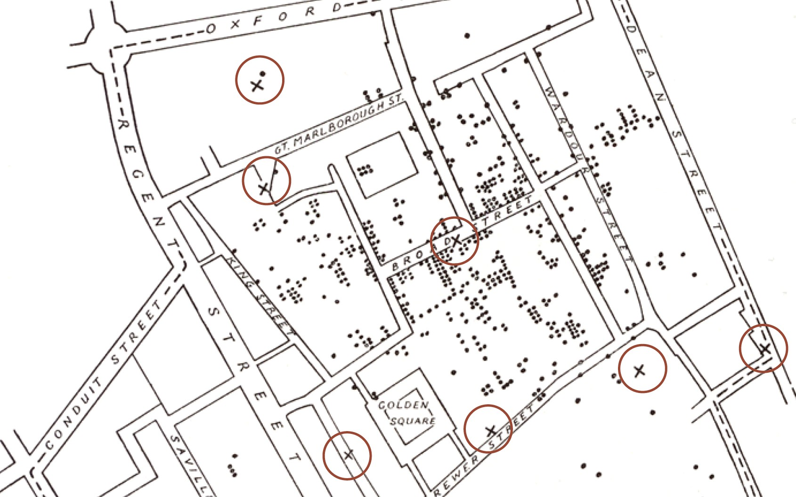

Does it help you spot trends?
More info here: http://en.wikipedia.org/wiki/1854_Broad_Street_cholera_outbreak

Slide 22
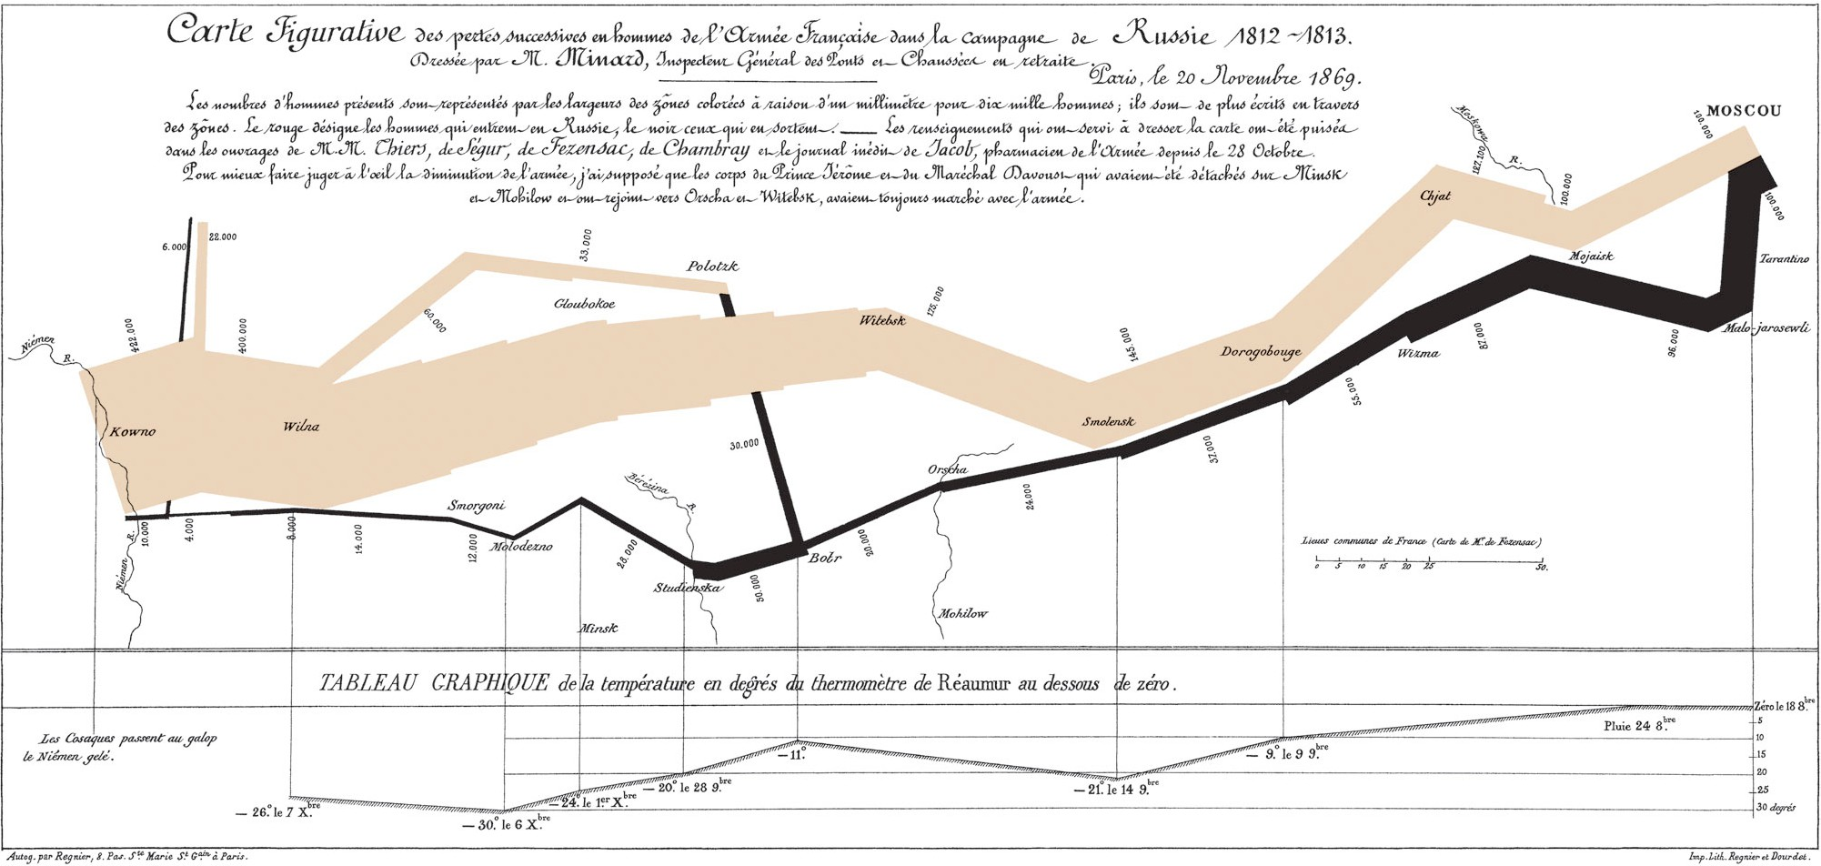
Does it tell a story?
“Figurative Map of the successive losses in men of the French Army in the Russian campaign 1812-1813.” Drawn by Mr. Charles Minard, Inspector General of Bridges and Roads in retirement. Paris, 20 November 1869.

Slide 23


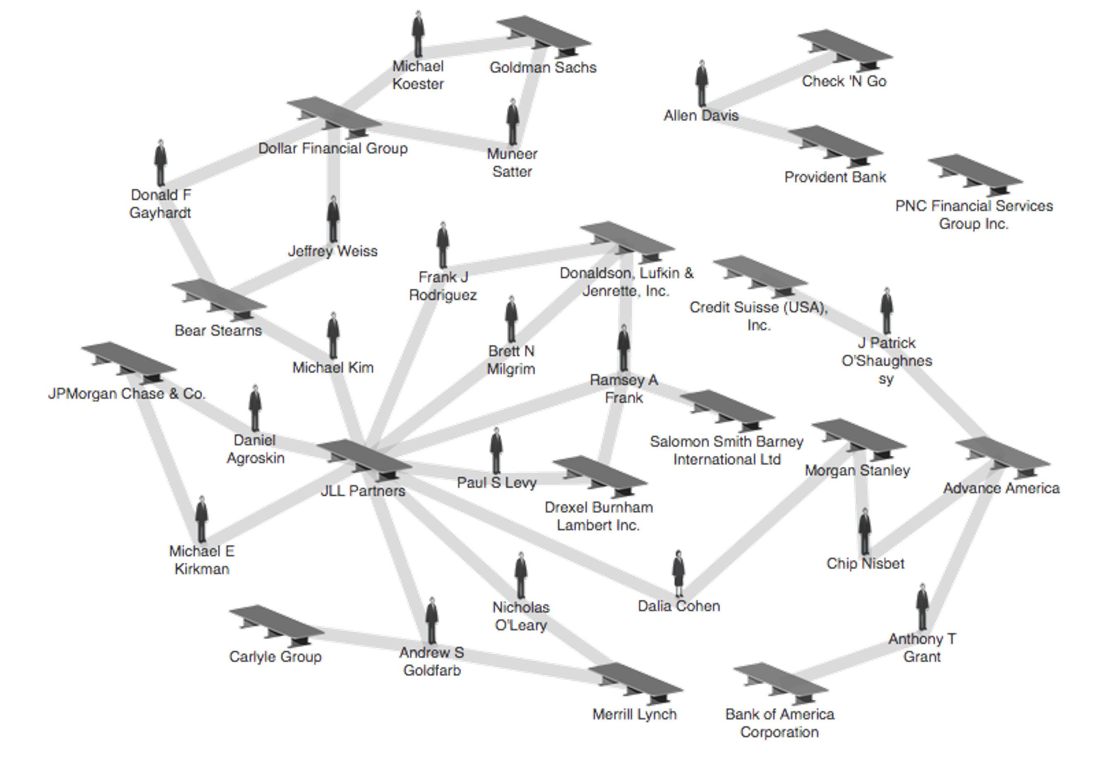







Does it help you explore?
Credit: theyrule.net

Slide 24

Does it tell a story?
Hans Rosling’s 200 Countries, 200 Years, 4 Minutes – The Joy of Stats – BBC Four
https://www.youtube.com/watch?v=jbkSRLYSojo

Slide 25

Recap: Jordan’s (def.)
Visual representations of data that reinforce human cognition

Slide 26

Data (def.)
a set of variables that capture various aspects of the world:
Tuition rates, enrollment numbers, public vs. private, etc.

Slide 27


Data (def.)
and a corresponding set of observations (a.k.a. records)
over these variables. For example:
tuition = $46,288, enrollment = 2,563, private, etc.

Slide 28

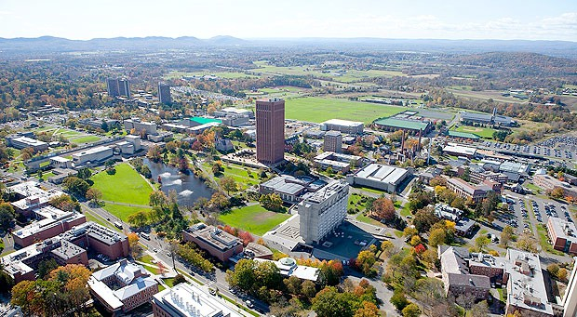

Data (def.)
and a corresponding set of observations (a.k.a. records)
over these variables. For example:
tuition = $16,115, enrollment = 28,635, public, etc.

Slide 29
One way to think about this:
VARIABLES
 | Tuition | Enrollment | Public vs. Private | …
Smith
_{College} $46,288 2,563 private
UMass
_{Amherst} $16,115 28,635 public
Hampshire
_{College} $48,065 1,400 private
Mount Holyoke
_{College} $43,886 2,189 private
Amherst
_{College} $50,562 1,792 private
⋮
OBSERVATIONS

Slide 30
Why is this important?
Data have dimensions
Visualizations have dimensions, too
To build visualizations, we need to map data dimensions to visual dimensions

Slide 31
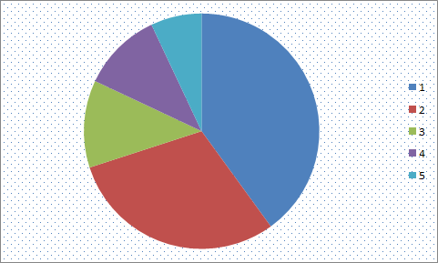
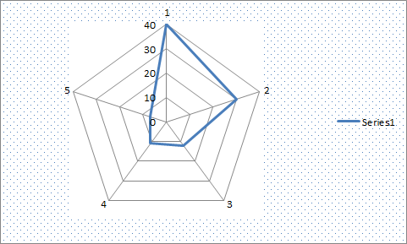
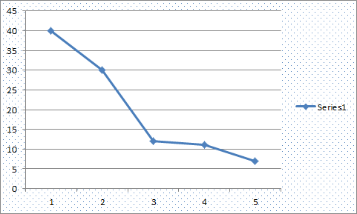
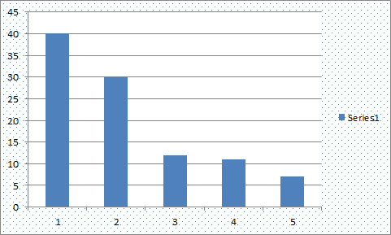
Key question for this course
Which data dimension should be mapped
to which visual dimension?

Slide 32
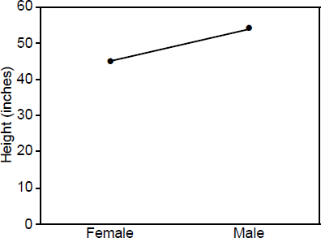
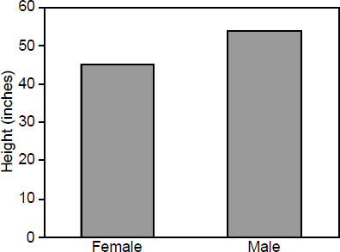
Answer: it depends
Average Height for Youth Sports Participants
Crew
Basketball
Crew
Basketball

Slide 33


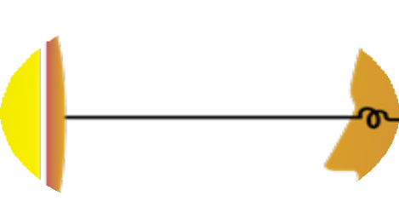
So what do we have to work with?
Image credit: Ali Ansari

Slide 34




Graphical primitives
The images we draw are composed of marks: like ink
Lines
Points
Areas

Slide 35
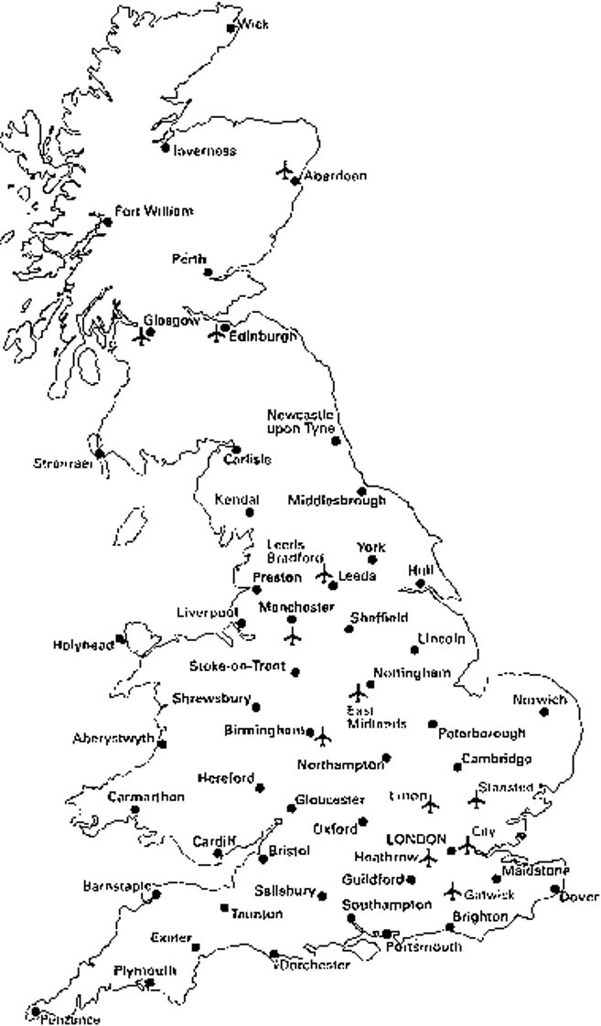
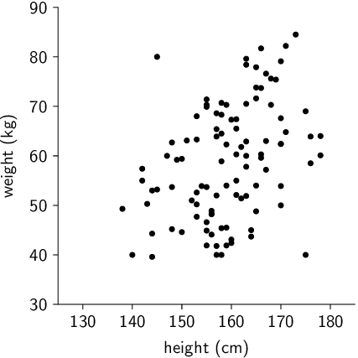
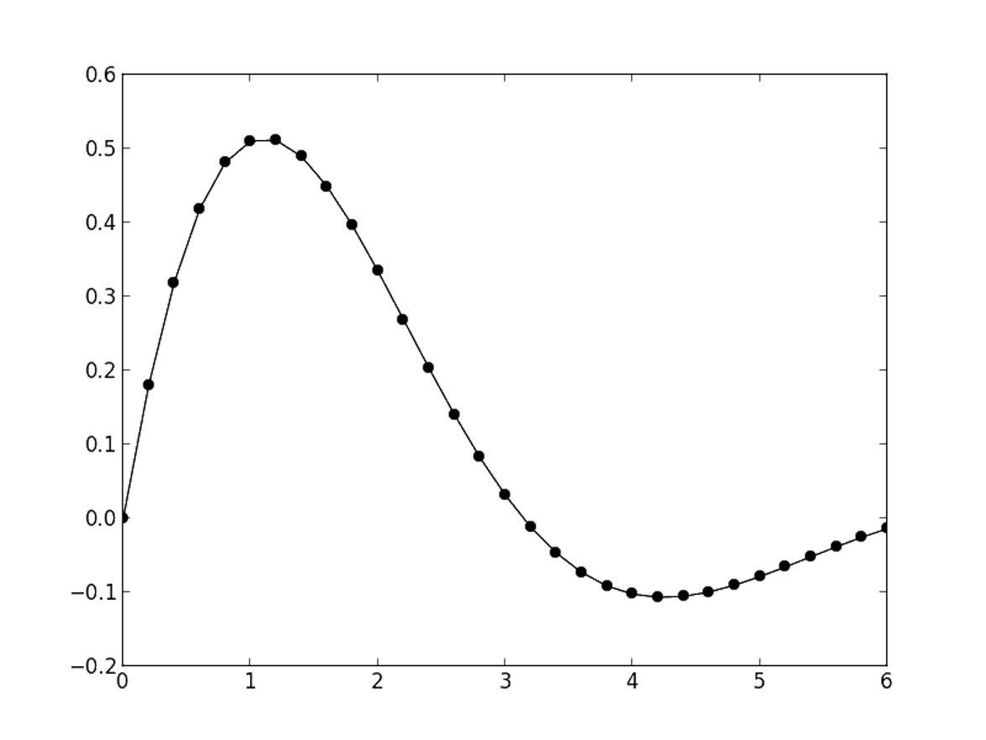
Visual dimension: position
Encode information using where the mark is drawn
Some examples:

Slide 36
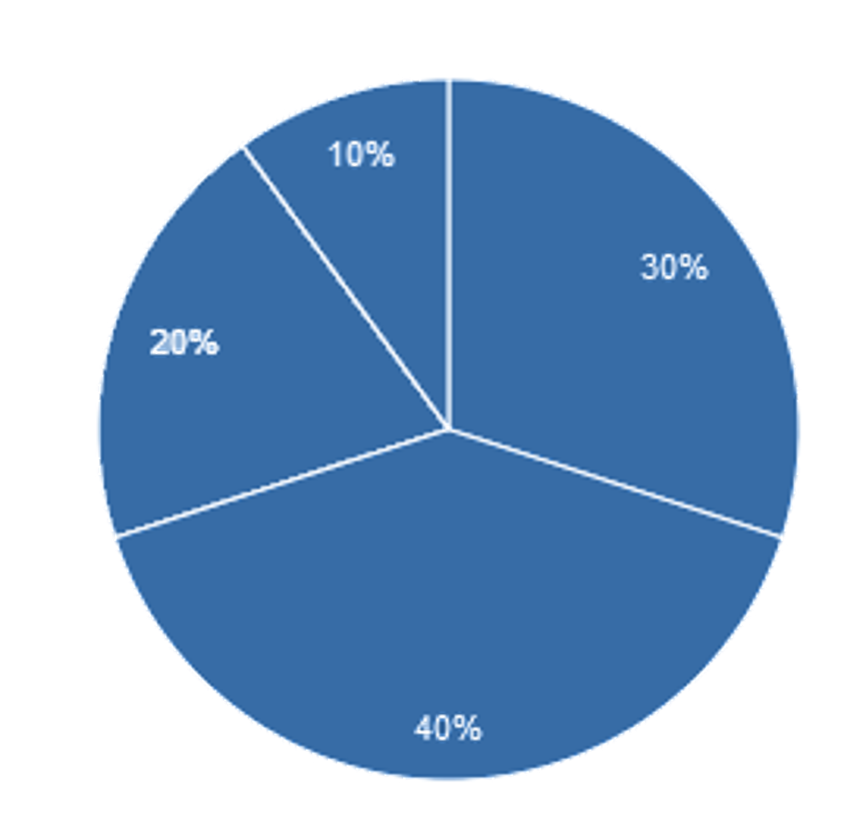
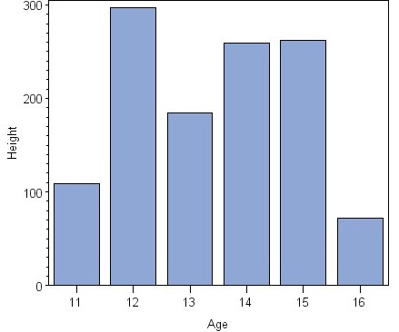
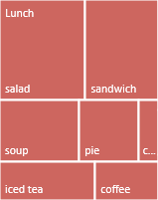
Visual dimension: size
Encode information using how big the mark is drawn
Examples:

Slide 37
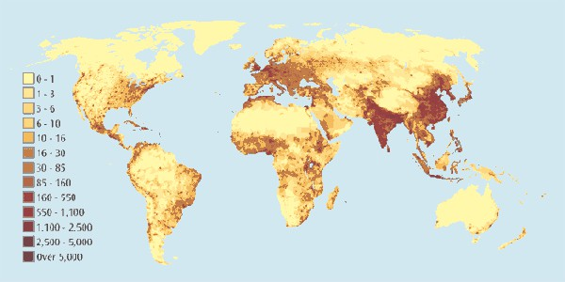
Visual dimension: value
Encode information using how dark the mark is drawn
Example:

Slide 38
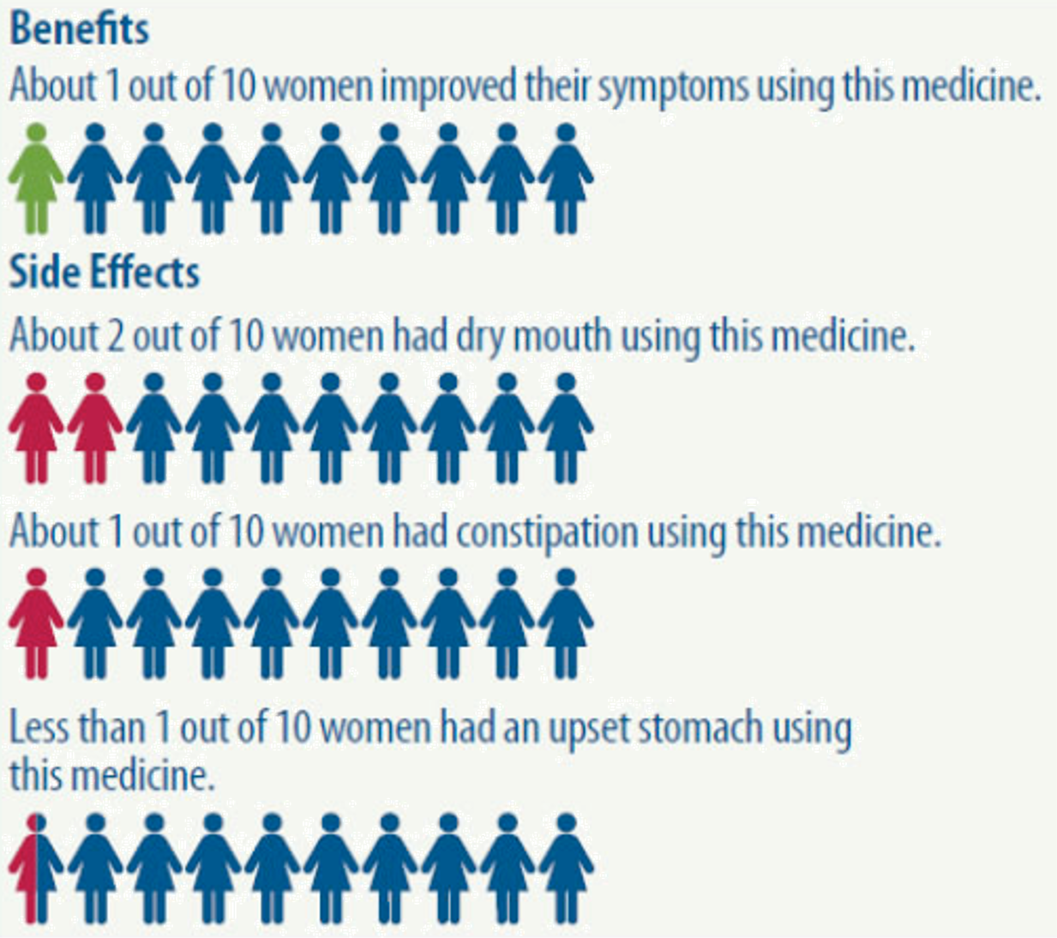
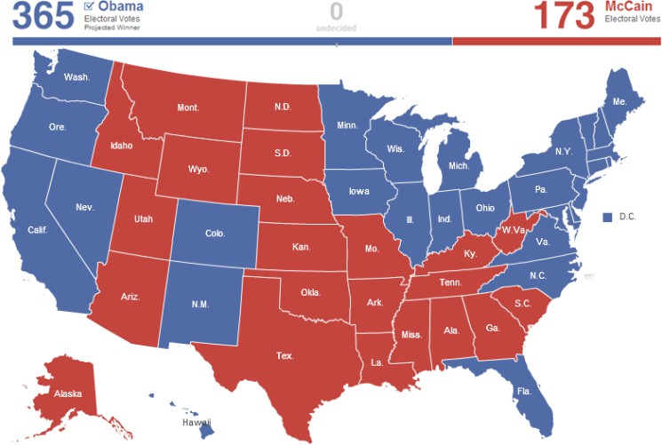
Visual dimension: color
Encode information using the hue of the mark
Examples:

Slide 39
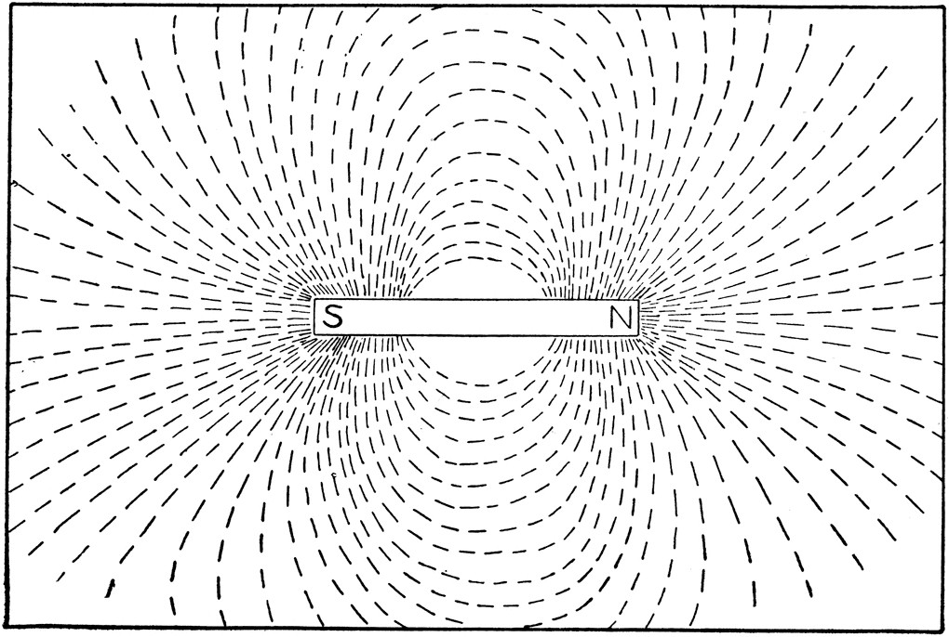
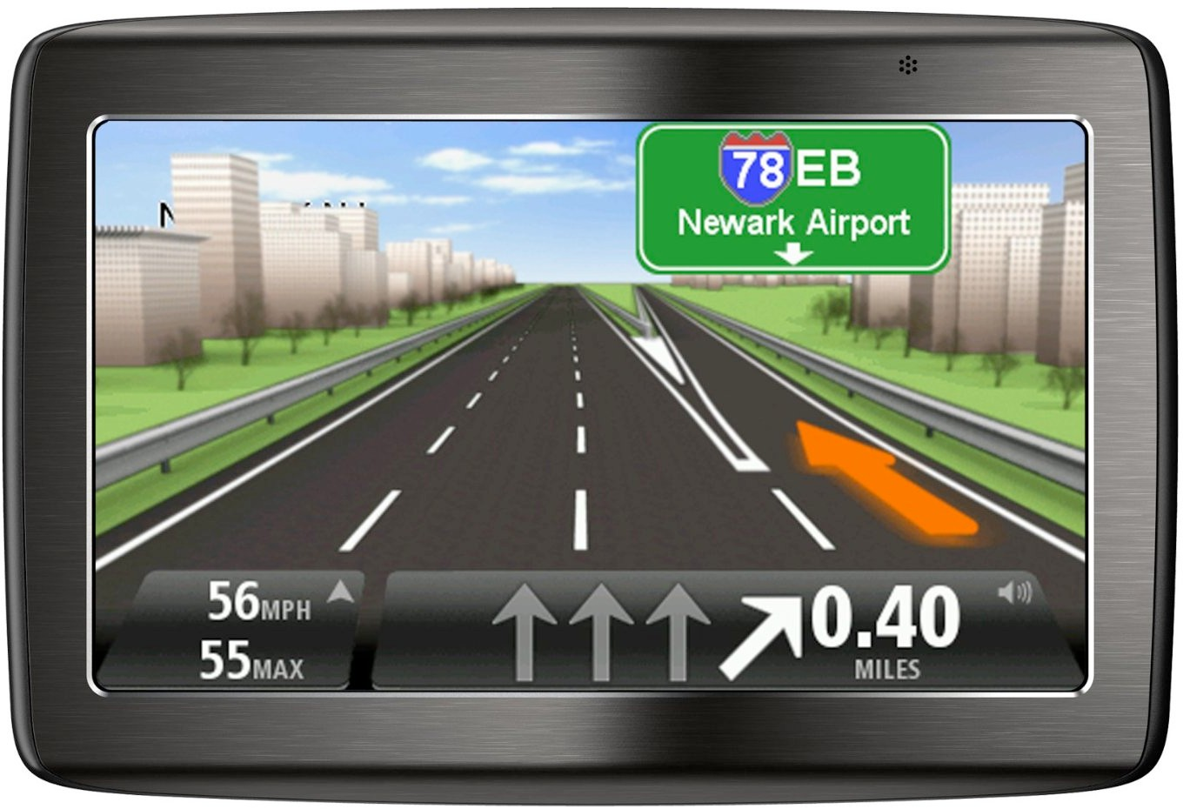
Visual dimension: orientation
Encode information using how the mark is rotated
Examples:

Slide 40



Visual dimension: shape
Encode information using how the mark is shaped
Examples:

Slide 41
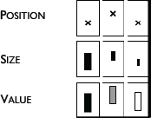
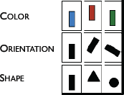

Discussion: visual dimensions & data type
Categorical Numerical
Jacques Bertin, Semiologie Graphique
(Semiology of Graphics), 1967.

Slide 42
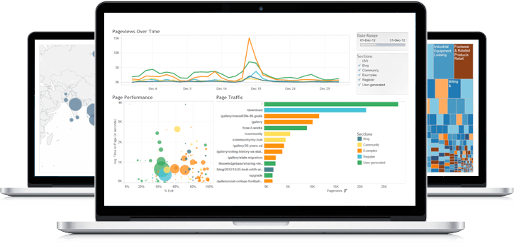
A sampling of visualization techniques

Slide 43
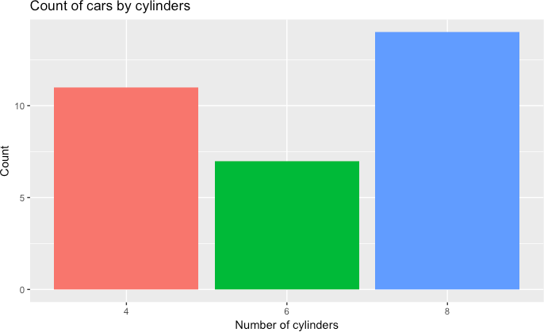
Bar chart
Used for comparable variables
Compares quantitative values for different categories
Highlights relative amounts
Grouped/stacked bars can break each category into sub-groups

Slide 44
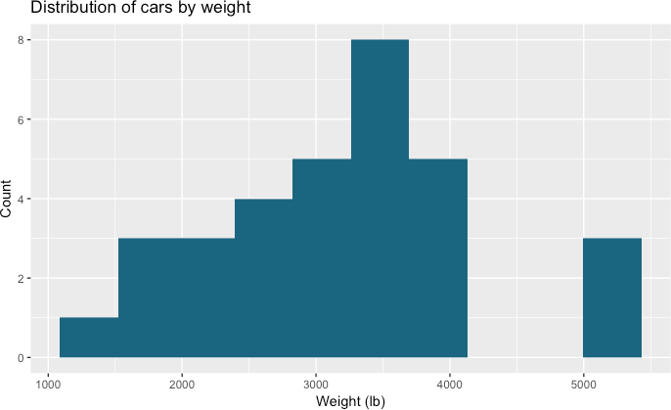
Histogram
Looks like a bar chart… but the x-axis is continuous
Y-axis shows count or relative frequency
Highlights distribution
Note: bin size makes a big difference!

Slide 45
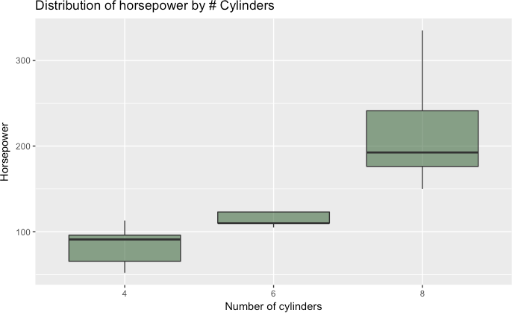
Boxplot
Also useful for highlighting distribution
Calls out key values:
median
1st & 3rd quartiles
“fences”
outliers
“fence” (1.5IQR)
₃rd quartile
outlier
median
₁st quartile

Slide 46
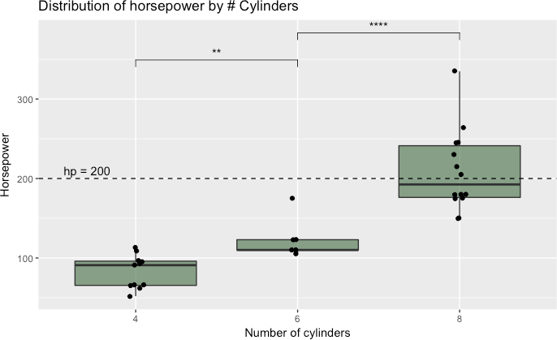
Boxplot add-ons
Use “jitter” to show actual values
Reference lines can help provide context
Can use annotations to show statistical significance

Slide 47
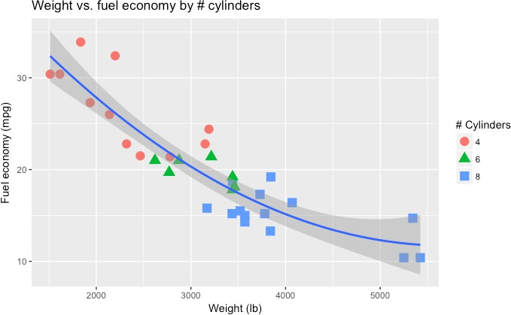
Scatterplot
Shows the relationship between two continuous variables
Each point in the plot represents an observation
You can change color or symbol to highlight groups
Sometimes useful to show a trend line (regression)

Slide 48
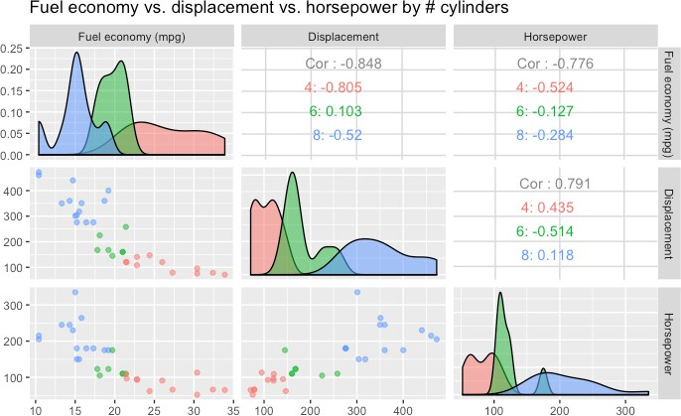
Scatterplot matrix (SPLOM)
Scatterplots show the relationship between just two
continuous variables at a time
We can combine multiple scatterplots into a matrix to show additional relationships

Slide 49
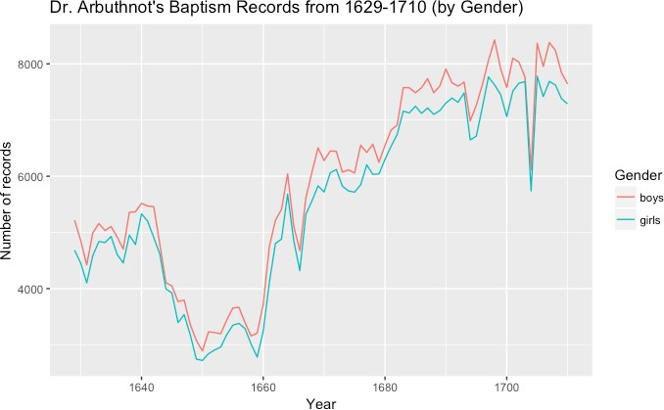
Line chart
Shows the trend in one variable, often over time
Multiple lines can show multiple variables, or the same variable for multiple observations (must have the same scale!)
Highlights “position switches”

Slide 50
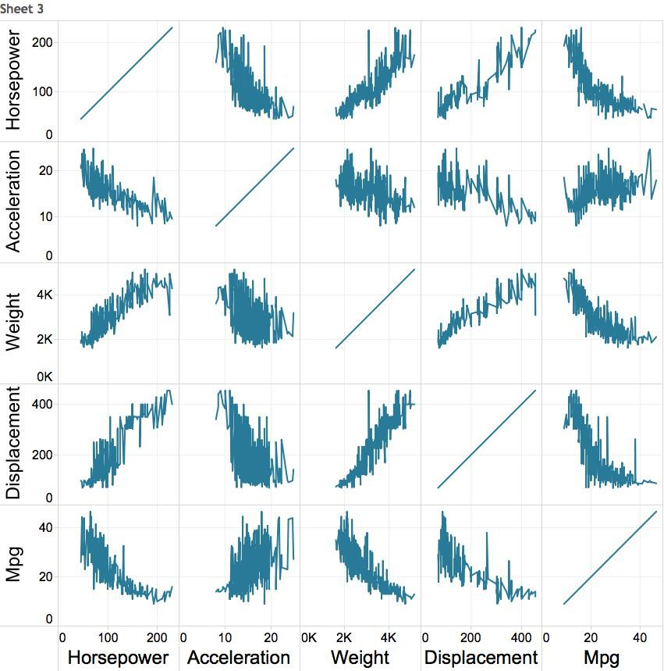

Multiple variables: line chart matrix?

Slide 51
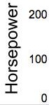






Weirder idea
H
A
W
D
M
“parallel coordinates plot”

Slide 52

Network
Useful for showing the relationships between entities
Can use color, size, etc. to encode additional information
Caveat: network diagrams quickly become hairballs for large, dense data

Slide 53

Map
Useful for analysis with a strong geographic component
Filled maps (choropleth) vs. points
Remember: color scale comparisons are harder for humans than size comparisons!

Slide 54

Data Challenge 1: Exploratory Data Analysis

